Slide 1
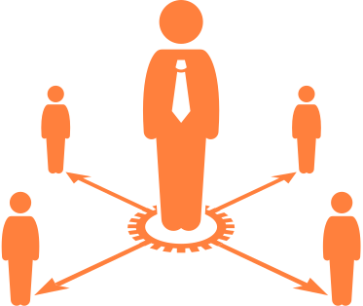








Environmental Life Cycle Business Model Canvas
SUPPLIES AND OUT-SOURCING
PRODUCTION
FUNCTIONAL VALUE
END-OF-LIFE
USE PHASE
MATERIALS
DISTRIBUTION
ENVIRONMENTAL IPMACT
ENVIRONMENTAL BENEFITS
Based on: www.sustainablebusinessmodel.org

